Slide 1
Housing Sales Prices & Venues Data Analysis of Manchester
Applied data science capstone – final assignment

Slide 2
Analysis of Manchester
Many young people are flocking to Manchester because of the wide range of opportunities as well as economic and cultural diversity.
The city attracts students, graduates, young professionals as well as investors.
The investors need to find a place where the real estate values are lower and the type of business they are interest in is not very intense. And the people a place with low real estate values and surrounded by venues of their preference.
This study aims to help people that want to move to Manchester make more informed decisions about which neighbourhood to live in.

Slide 3
Data sources
Neighbourhood’s names, postcode, latitude and longitude coordinates from the ‘Postcodes in Manchester’ dataset from doogal.co.uk/AdministrativeAreas
Median house sale price paid by neighbourhood in England in 2018 from the ‘HPSSA dataset 37’ from Office for National Statistics
Most common venues in Manchester, their name, neighbourhood, location and category from Foursquare API.
Neighbourhood boundaries from the Manchester City Council website.

Slide 4
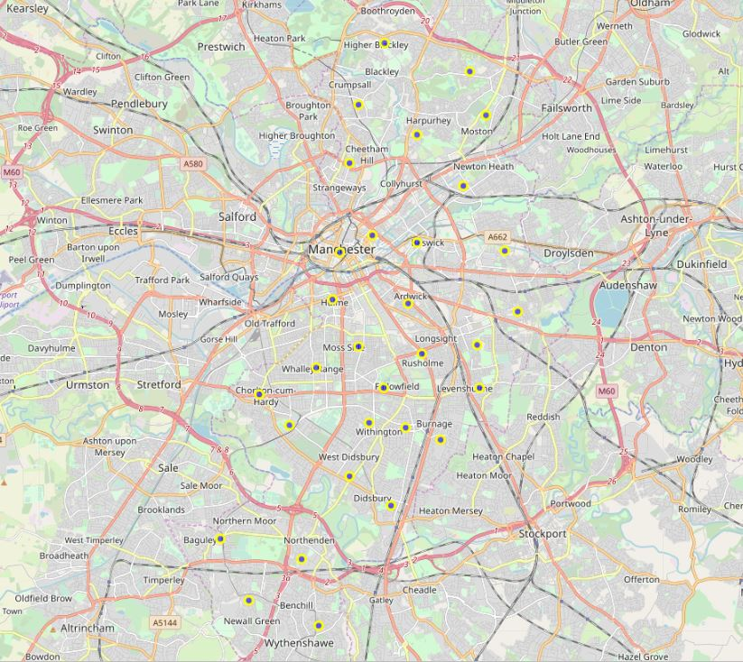
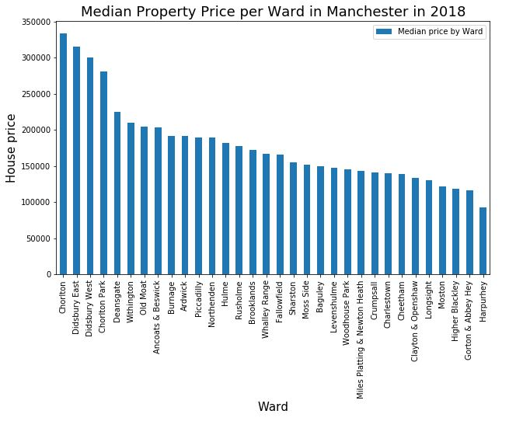
Manchester neighbourhoods
Chorlton, Didsbury East, Didsbury West and Chorlton Park are the most expensive neighbourhoods.

Slide 5
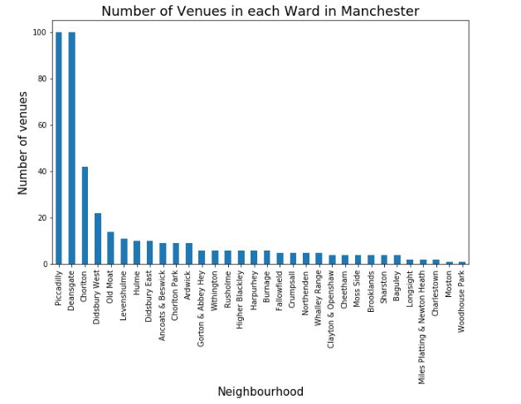
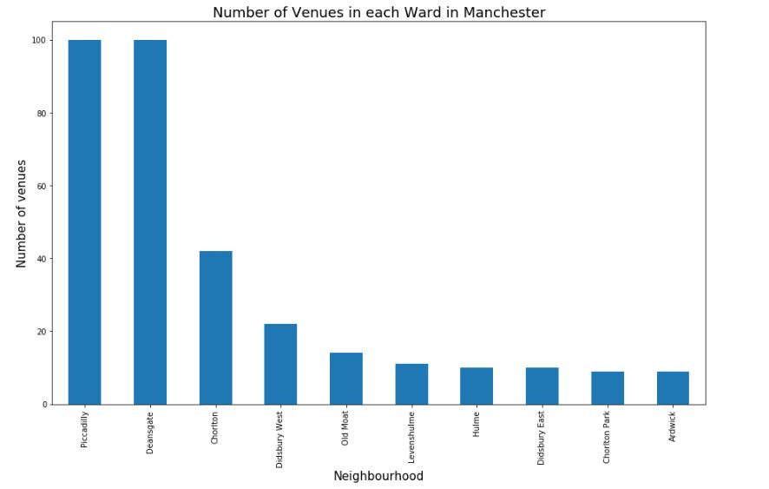
Number of venues
As some of the neighbourhoods have such a small number of venues, only the top 10 areas with the most venues will be considered in this analysis.

Slide 6
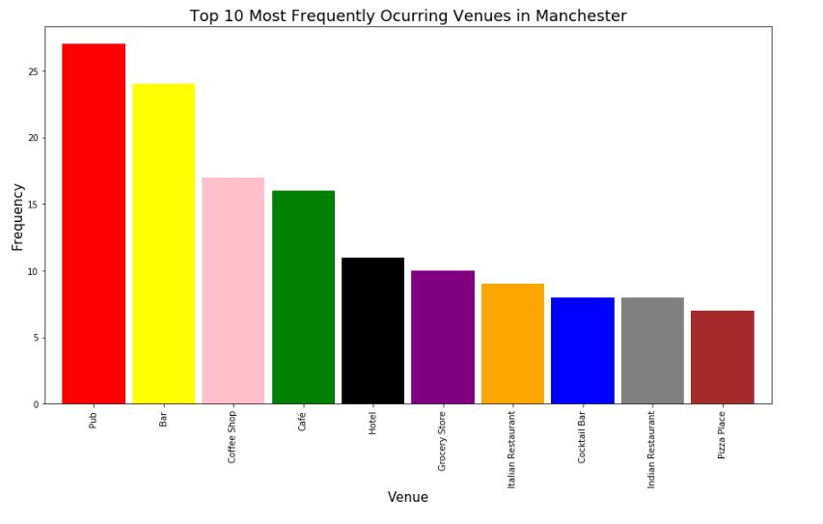
Most frequently occurring venues in Manchester
Considering the top 10 neighbourhoods, 106 unique venue categories were returned by Foursquare.
Pubs & bars top the charts.

Slide 7
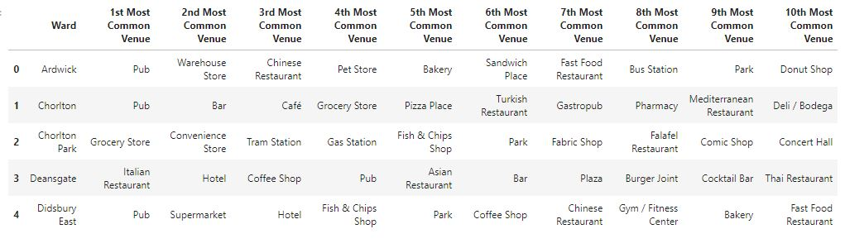
10 Most Common venues per neighbourhood
Table produced using one-hot encoding process.
Shows the frequency of occurrence of venue categories in each neighbourhood.

Slide 8
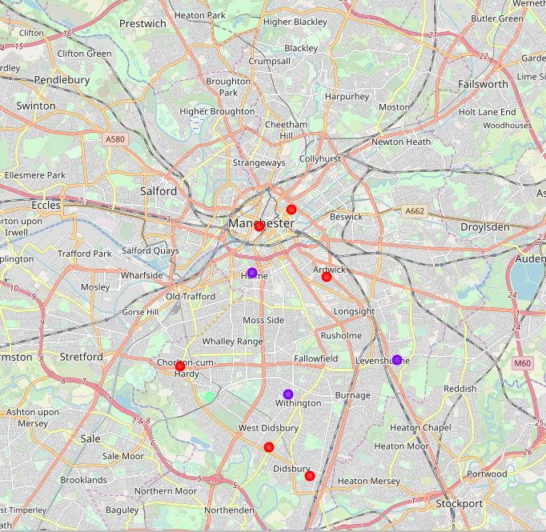
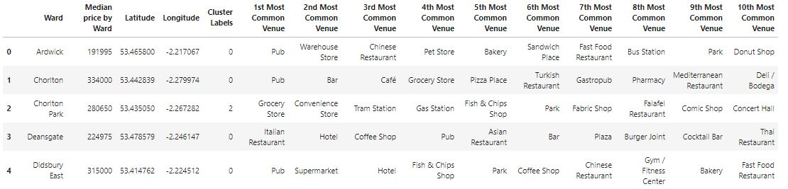
Neighbourhood segmentation – venue category
Because there are some common venue categories in the areas, we will use the unsupervised machine learning K-means algorithm to cluster the neighbourhoods.

Slide 9
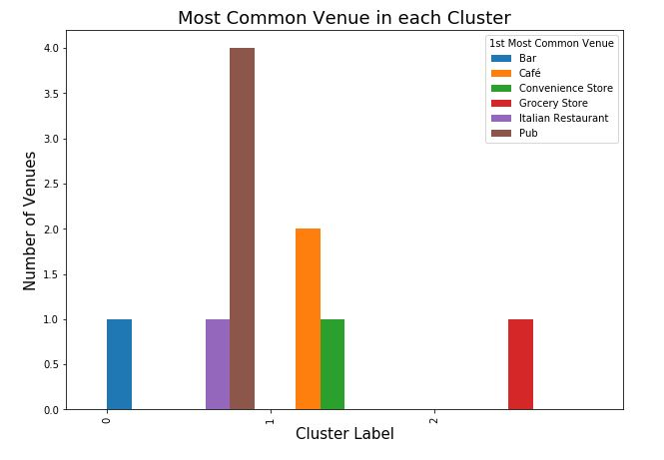
Analyzing each cluster
Cluster 0: “Drinking cluster”
Cluster 1: “Eating cluster”
Cluster 2: “Residential cluster”

Slide 10
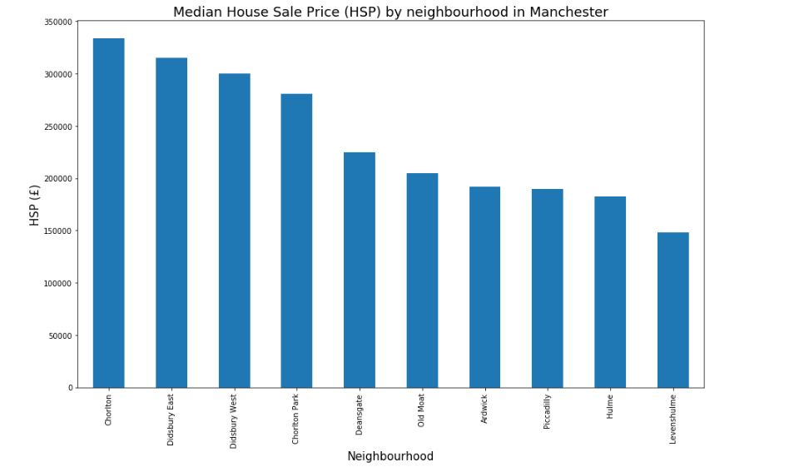
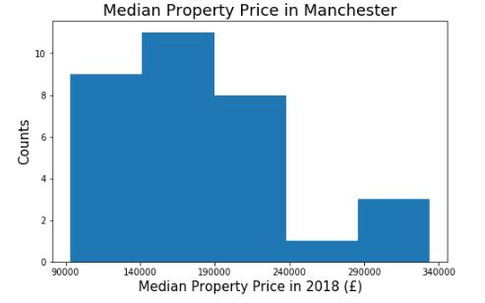
House sale price in Manchester (2018)
Up to £140k: Low-1 Level House Price
£140k-£190k: Low-2 Level House Price
£190k-£240k: Mid-Level House Price
£240k-£290k: High-1 Level House Price
More than £290k: High-2 Level House Price

Slide 11
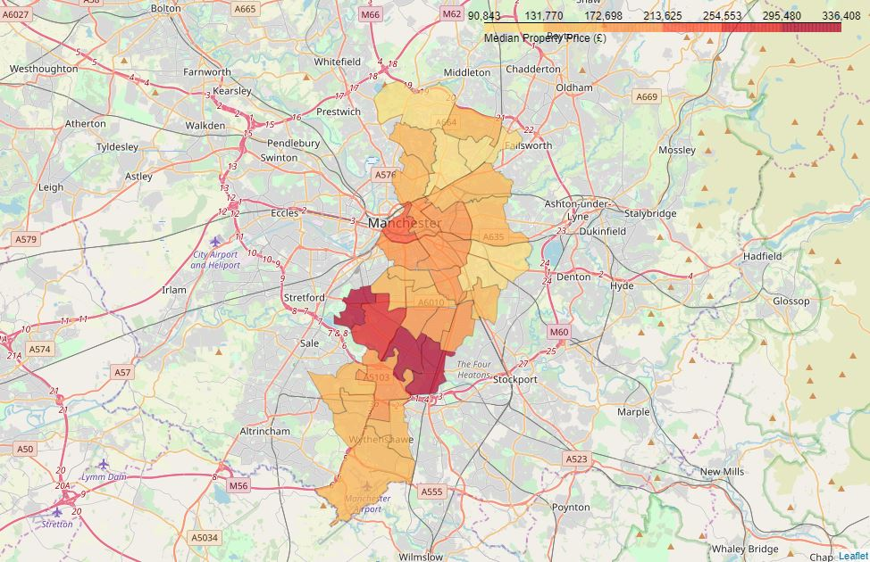
House sale price – Choropleth map
The darker colours represent the neighbourhoods with highest sale price: Chorlton, Didsbury East, Didsbury West and Chorlton Park.

Slide 12
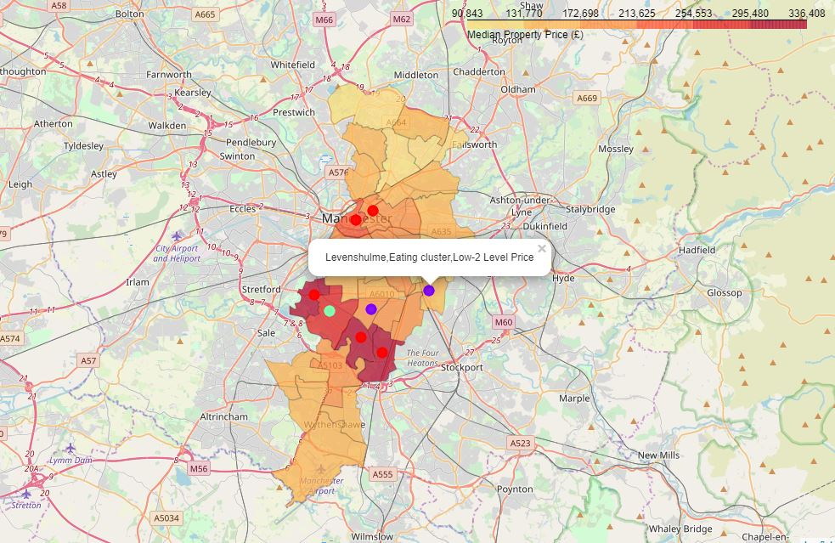

Slide 13
Results & Discussion
The top venues in Manchester are pubs and bars.
Chorlton, Didsbury East, Didsbury West and Chorlton Park have the highest house sale price and are also among the neighbourhood with the most venues in Manchester.
Ardwick, Chorlton, Deansgate, Didsbury East, Didsbury West and Piccadilly are dominated by pubs and bars as the most common venue whereas Hulme, Levenshulme and Old Moat are dominated by cafes and restaurants as most common venues.
Chorlton Park was separated from both of these clusters as grocery stores stand out as the most common venue - residential area.

Slide 14
Conclusion & future directions
Analyzed the results of segmentation of the neighbourhoods into clusters based on the most common venues using k-means algorithm.
Built a choropleth map, which contains name of neighbourhood, name of cluster and house sale price range.
Not the only considerations when buying a property or opening a business, but it certainly gives us some very important preliminary information about the neighbourhoods and serving as guidance for the next step.
Ideas include: the median house sale price data from the years 1995 to 2018 to predict the values for 2019 using regression.

Slide 15
Thanks!

